Slide 1
Los Angeles Crime Statistics
Group 3: Diego Sanchez Rodriguez, Jennifer Mazas, Leonardo Ortiz, William Fung

Slide 2
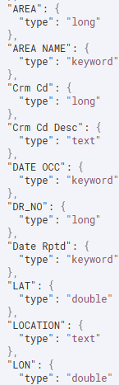
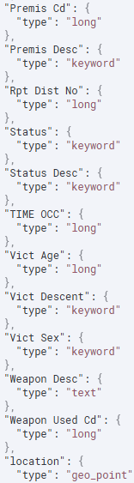
Data Structure
Processing Information
Data Size: 193.1MB
Source: Kaggle
Important Fields i.e. Crm CD

Slide 3
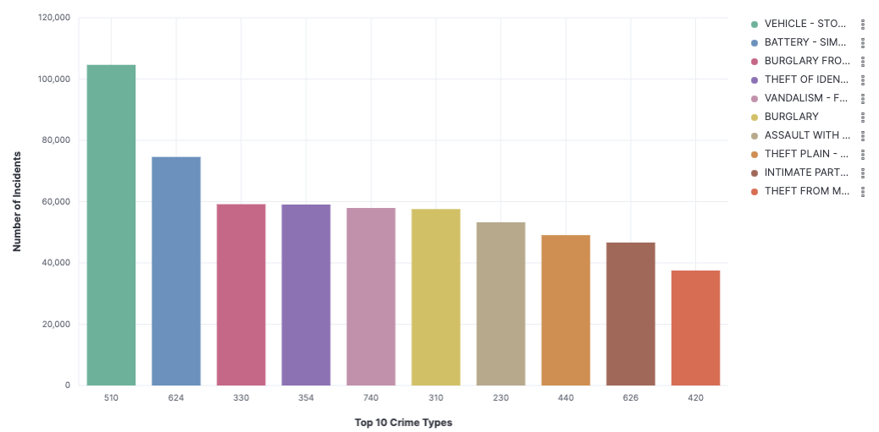
Crime Frequency Across Categories
Notes:
510: Vehicle Theft - Over 100,000 incidents, highest category.
624: Assaults - Second highest with ~70,000 incidents.
Consistently high numbers for 330 (Burglary), 354 (Theft), and 740 (Property Crime)
Property and vehicle-related crimes dominate the top 5.
Violent crimes such as assaults remain prevalent.

Slide 4
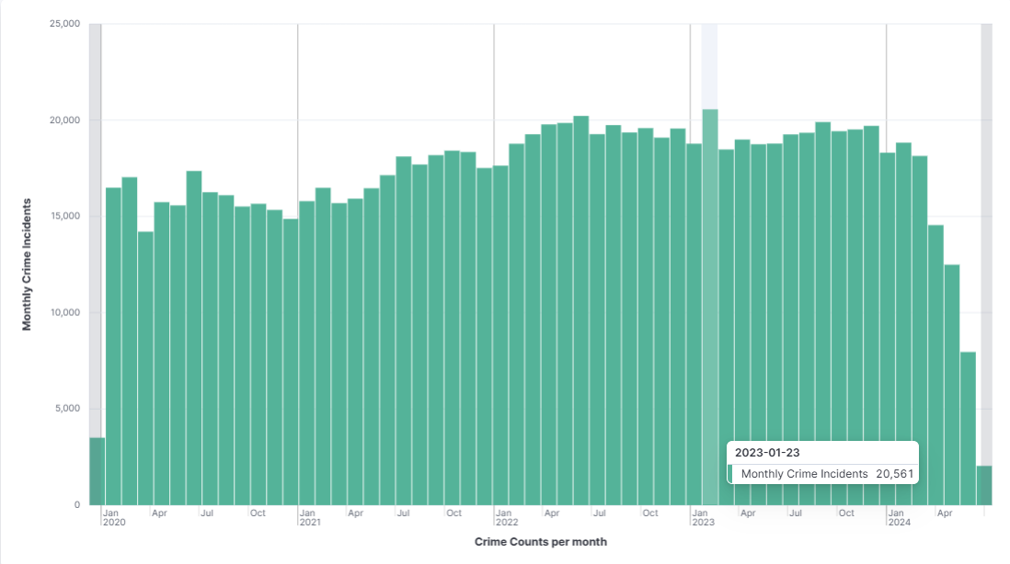
Monthly Crime Trends
Notes:
Crime incidents show a steady increase from 2020 to early 2023.
Peaks observed around mid-2022 and early 2023, with over 20,000 incidents in January 2023.
Recent months show a slight decline in incident counts.

Slide 5
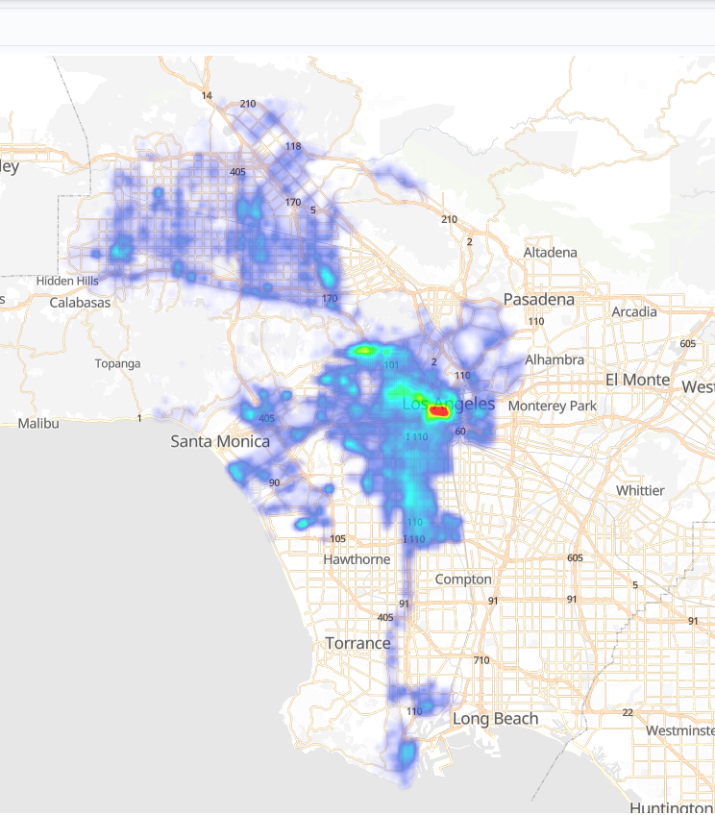
Crime Density Heatmap (Zoomed-Out View)
Notes:
The heatmap highlights crime density across Los Angeles County from 2020 to the present.
Downtown Los Angeles emerges as the primary hotspot, with high crime density extending southward through South Central and toward Long Beach.
Red zones indicate the densest areas, helping identify critical regions for intervention.

Slide 6
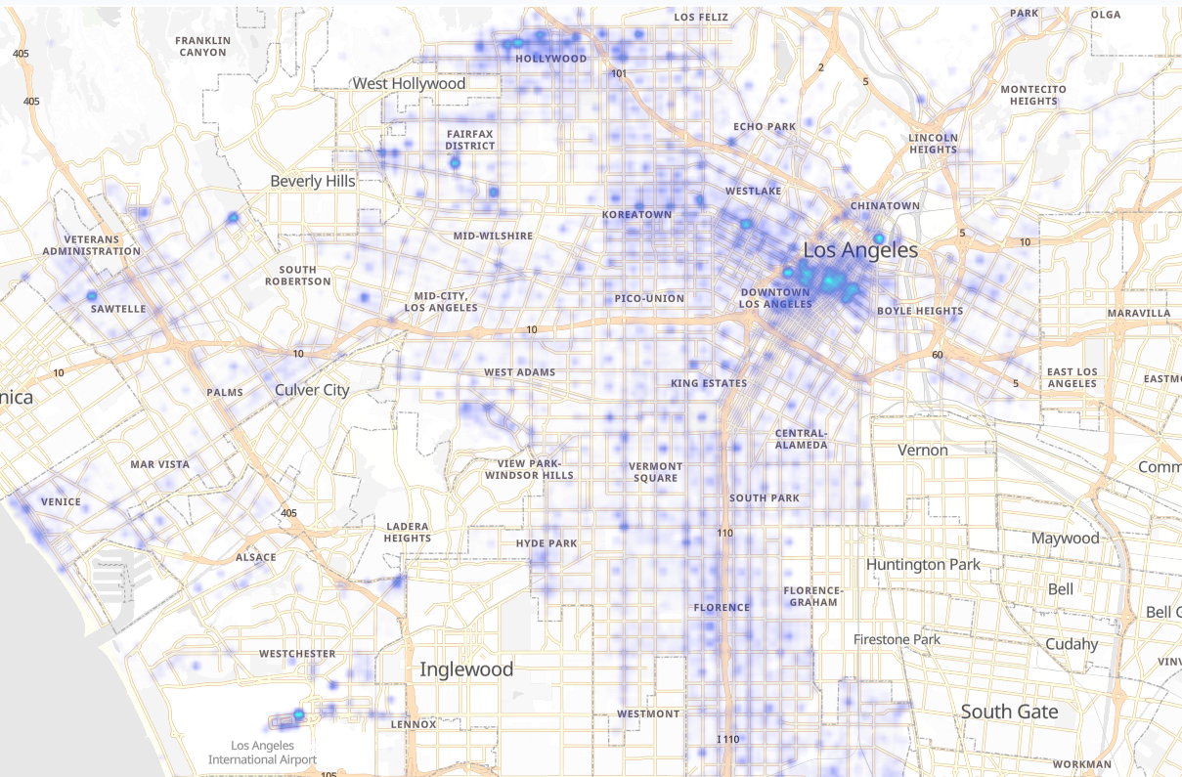
Crime Density Heatmap (Zoomed-In View)
Notes:
Hotspot Areas:
Downtown Los Angeles: Highest concentration of reported crimes.
Koreatown and Hollywood: Other major hotspots.
Surrounding Neighborhoods:
Boyle Heights, Westlake, and South Los Angeles: Areas with significant crime activity.

Slide 7
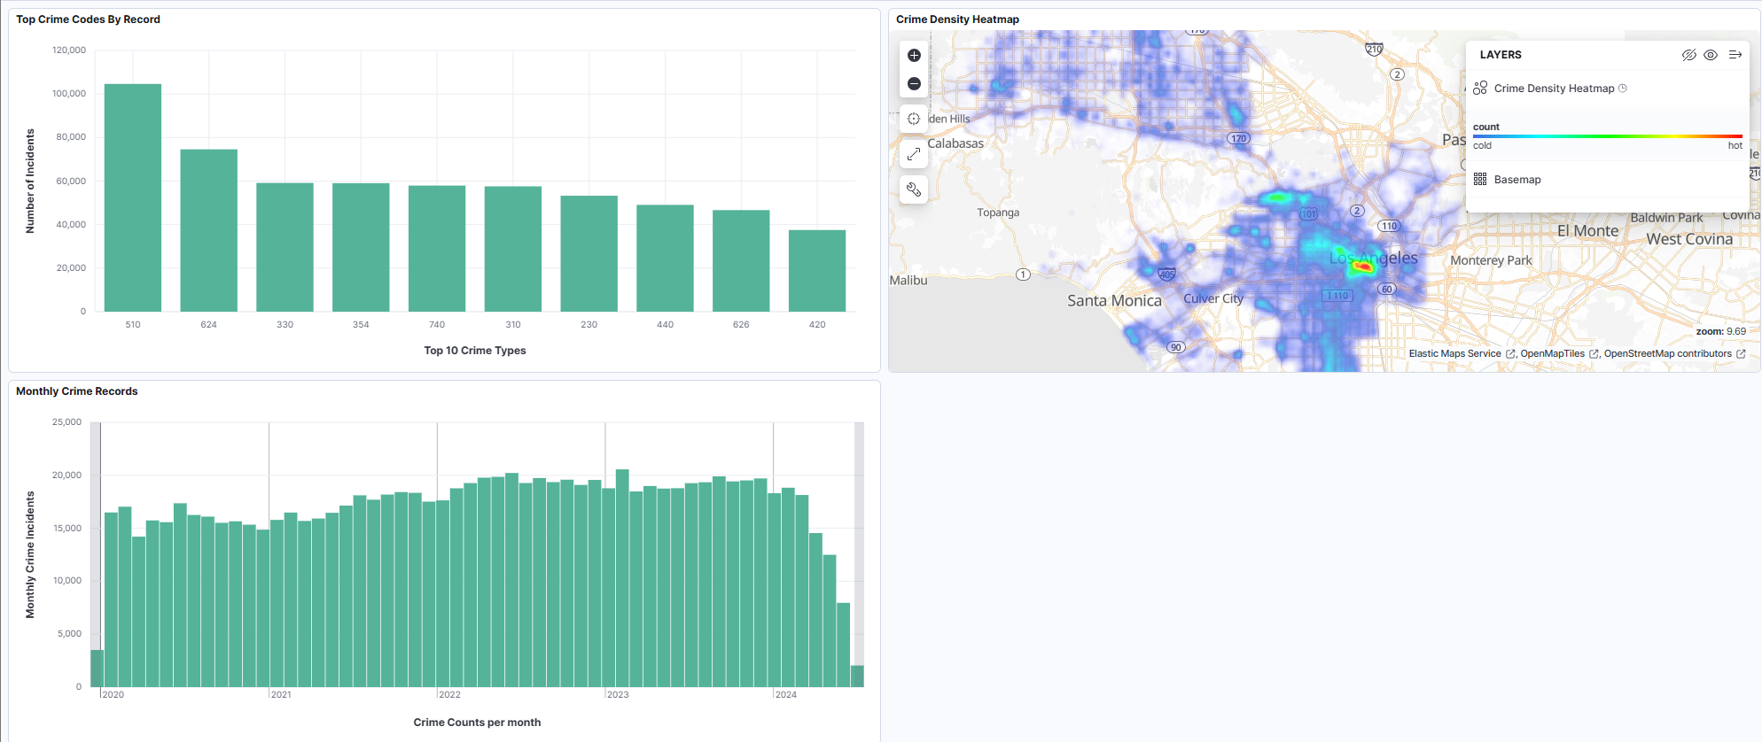
Los Angeles Crime Data Dashboard
Notes:
dashboard integrates key visualizations from the dataset to highlight crime patterns, trends, and hotspots across Los Angeles. dashboard serves as a critical tool for visualizing actionable insights that can guide law enforcement strategies and community outreach programs. Dashboard shows: Overview of Crime Density: Major hotspots, including Downtown Los Angeles and surrounding neighborhoods, are visualized for high-density areas.
Temporal Analysis: Crime trends over time reveal fluctuations in reports by month, helping to identify seasonal or periodic crime surges.
Category Breakdown: Highlights the most reported crime types, showcasing areas of specific concern.

Slide 8
Machine Learning
Specifications
Anomaly Detection

Slide 9
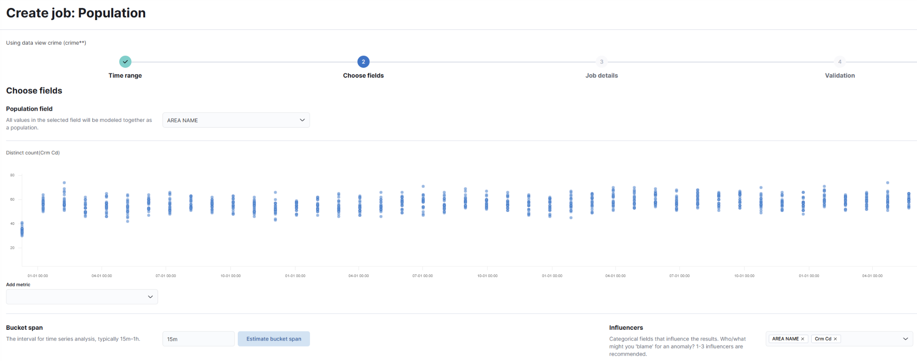
Machine Learning Specifications

Slide 10
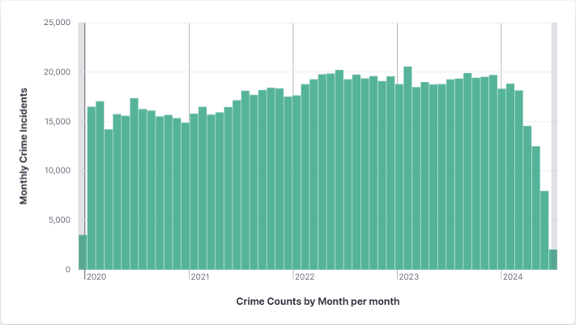
Anomaly Detection
Finding anomalies in data
Outliers relative to population
Disclaimer

Slide 11
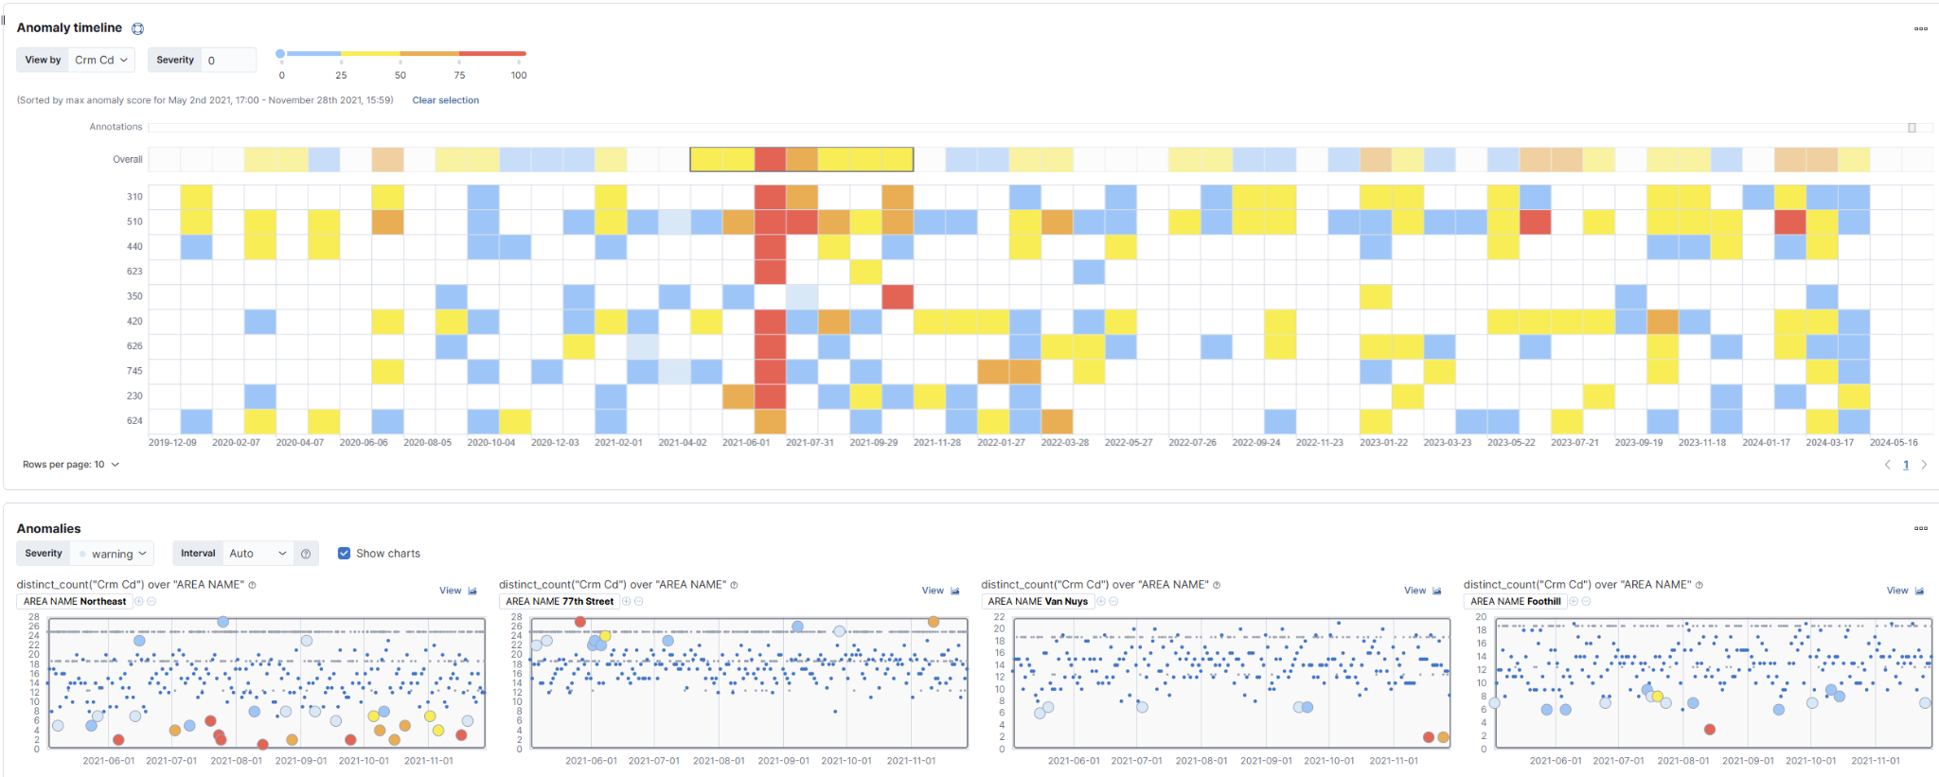
Anomaly Sample
2021 Period of Anomaly / Crm Code 510

Slide 12
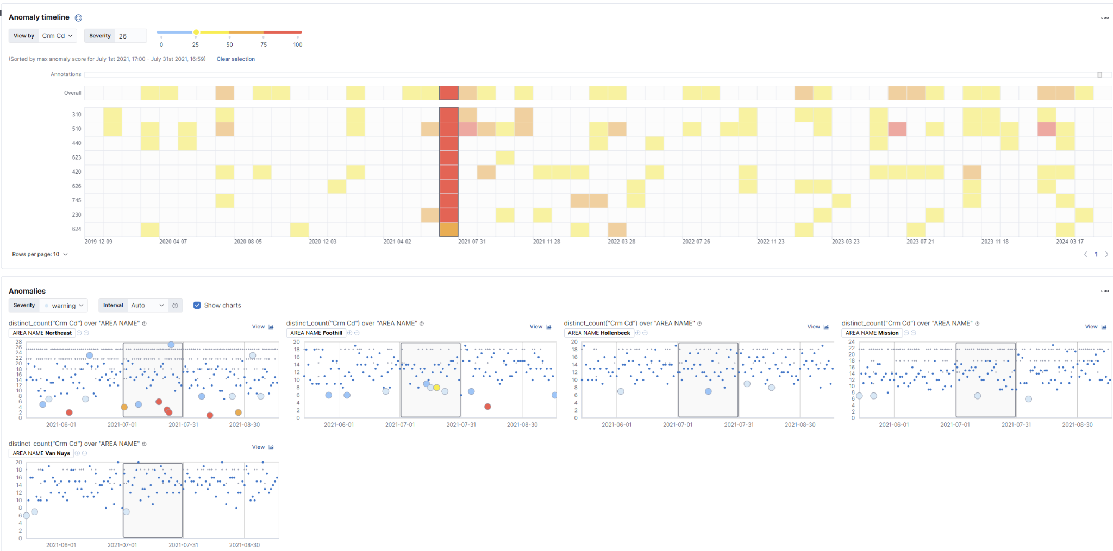
What is it?

Slide 13
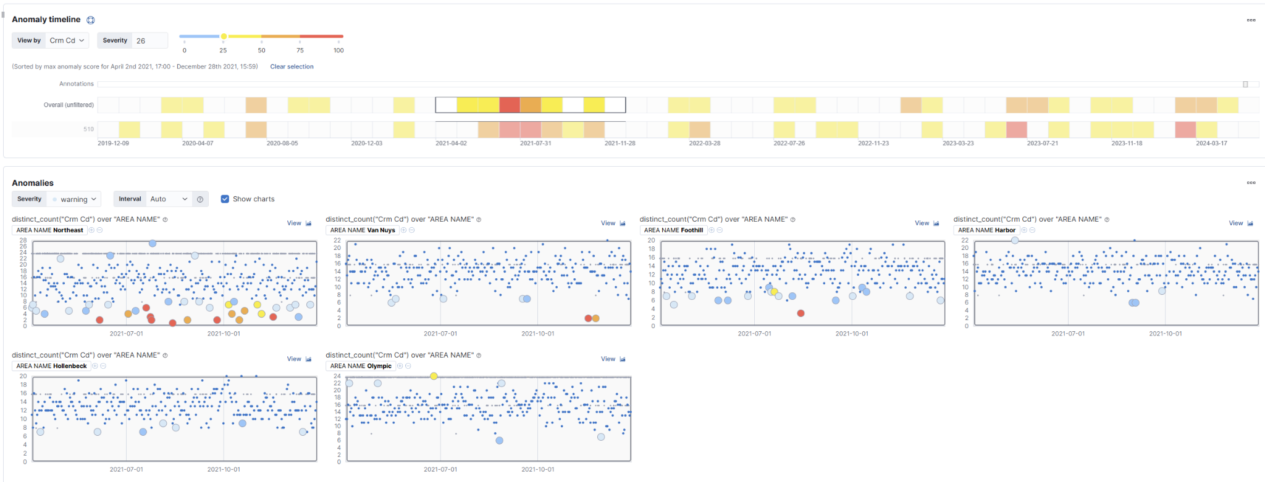
Anomaly Sample cont.

Slide 14
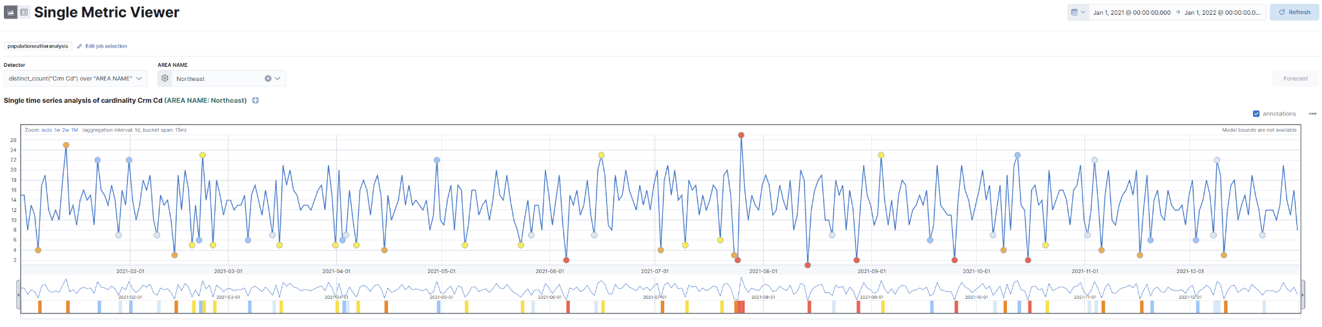
How safe is Northeast?

Slide 15
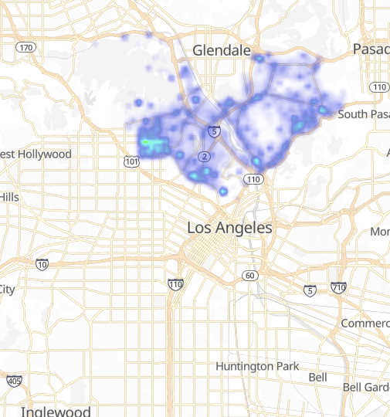
Northeast

Slide 16
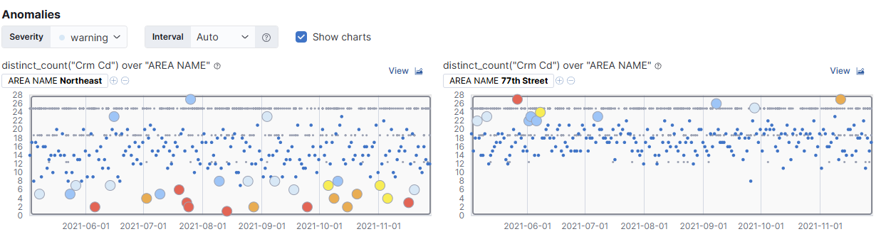
Other Direction

Slide 17
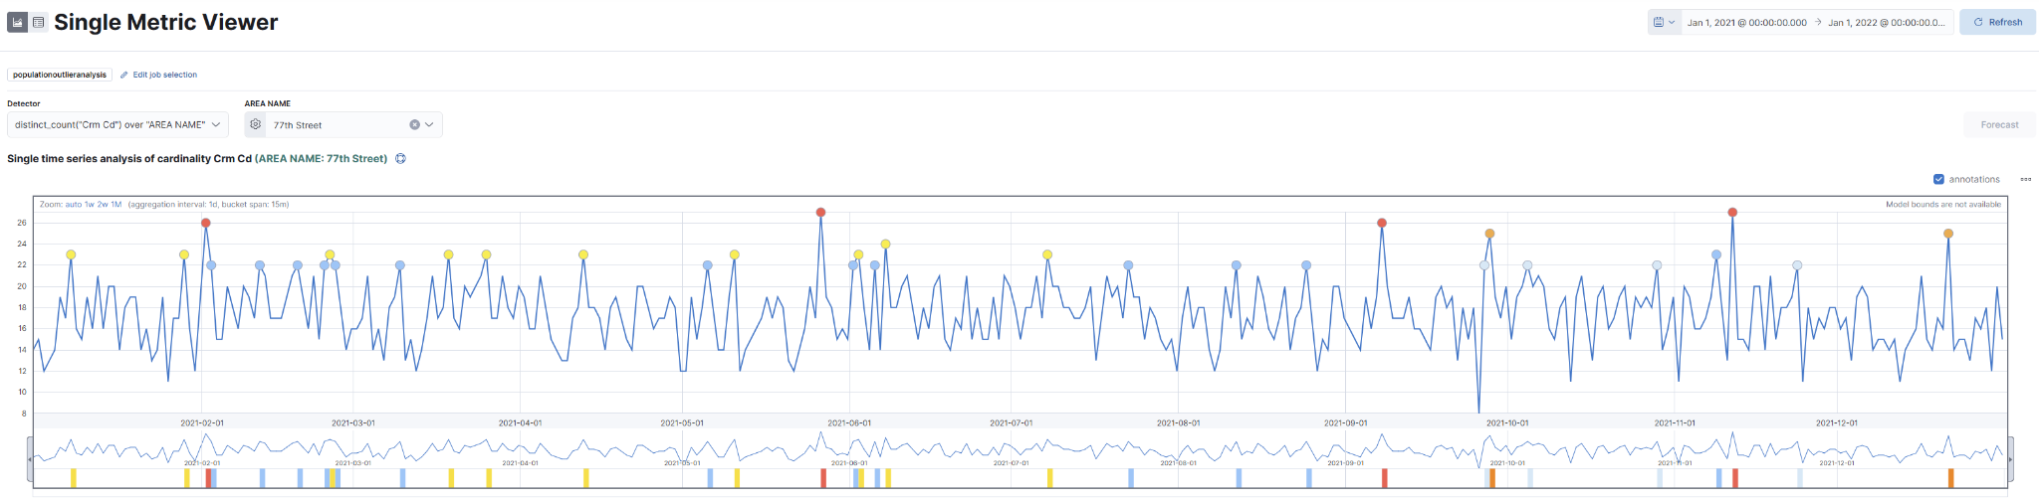
More Anomalies

Slide 18
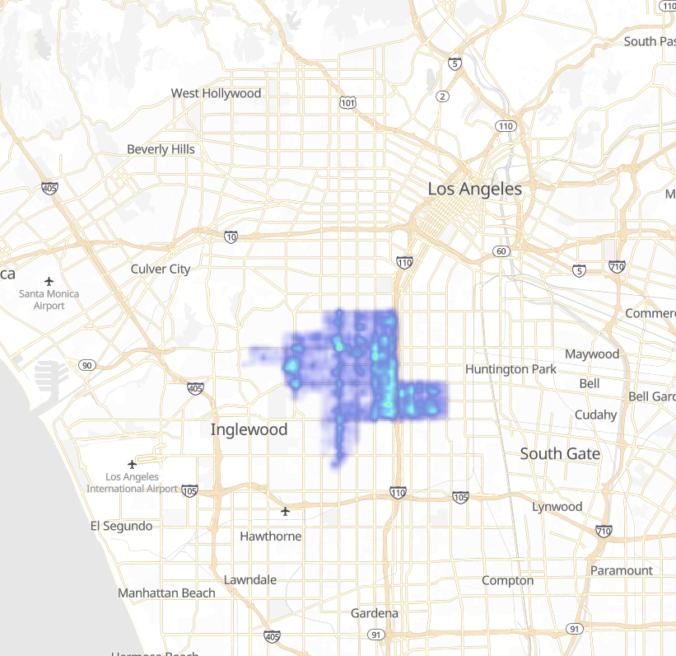
77th Street

Slide 19
Conclusion
Crime in Los Angeles
Including areas
Better data analysis

